Slide 1
Network Security - Homework 2
Apoorv Gahlot

Slide 2
Table of Contents
Overview
Project Goals
Project Execution Highlights
Security Policy
Overview of Threat Model
Objectives Achieved (and not achieved)
What was Learned

Slide 3
Overview
The project comprised mainly of 3 parts:
Reconnaissance
Passive sniffing of JHU_NSPUBLIC_WEP Network
Required setting up wlan0 in monitor mode to monitor packets in wireshark (found the traffic was encrypted)
Attack Preparation (Aircrack-ng)
Collected the network information ( BSSID, ESSID, MAC address of clients & Channel) via airodump-ng command
Captured Initialization Vectors (IV) in order to crack the WEP key via airodum-ng
To increase the flow IVs, I made use of aireplay-ng to carry out a ARP Request Replay attack
We had to stimulate the ARP request initially by deauthenticating an associated client.
Decrypted the IVs in order to obtain the WEP key with the help of aircrack-ng

Slide 4
Overview
Intrusion
With WEP key obtained from the previous step, I was able to associate my machine with the JHU_NSPUBLIC_WEP Network
My next step was to run nmap tool against one of the hosts idenfied in previous steps
Found few open ports running with few services
Found that one of the open port (21) was running a FTP Service and allowed anonymous login.
Uploaded a file on that machine

Slide 5
Project Goals
Collecting information about the Encrypted Network
Gaining Access to the Network by cracking the WEP Key
Infiltrating on one of the hosts in the network to upload a file
Security Implication ( Avoid Using WEP )

Slide 6
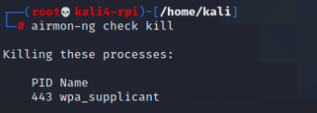

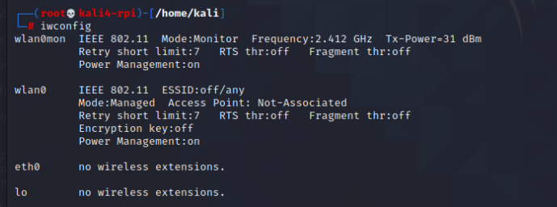
Project Execution
Configured the Network Interface wlan0 in monitor mode
Stopped NetworkManager service
Killed wpa_supplicant service with the help of airmon-ng check kill cmd
Monitored Traffic via Wireshark on wlan0mon interface

Slide 7
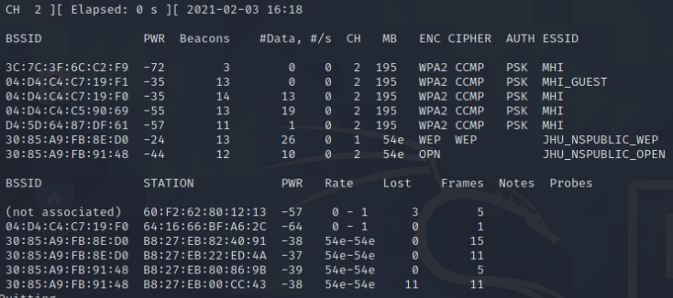
Project Execution
In order to crack the WEP Key, we need few key information :-
BSSID (MAC Address of the target Access point)
ESSID (Name of the Access Point)
MAC Address of any associated Clients
Channel
We collected this information with the help of aircrack-ng tool (Airodump command to be specific

Slide 8
Project Execution
After collecting the required information, I proceeded to crack the WEP Key.
I also spoofed my MAC address with the help of macchanger (-m)
In order to crack the WEP Key with the help of Aircrack-ng suite, we need to collect initialization vectors (IVs)
These IVs are contain small encrypted portion of the WEP key
To achieve this we captured the data via airodump-ng command and stored in a file with the help of one of the commands parameter (-w)
I initialized an ARP Request Replay attack (-3) with the the aireplay-ng command to increase the flow of Ivs
Since initially I was unable to collect ARP request, I made the client deauthenticate by sending 4 deauth packets (-0)

Slide 9
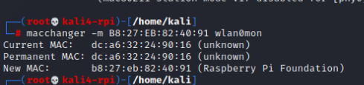
Project Execution

Slide 10
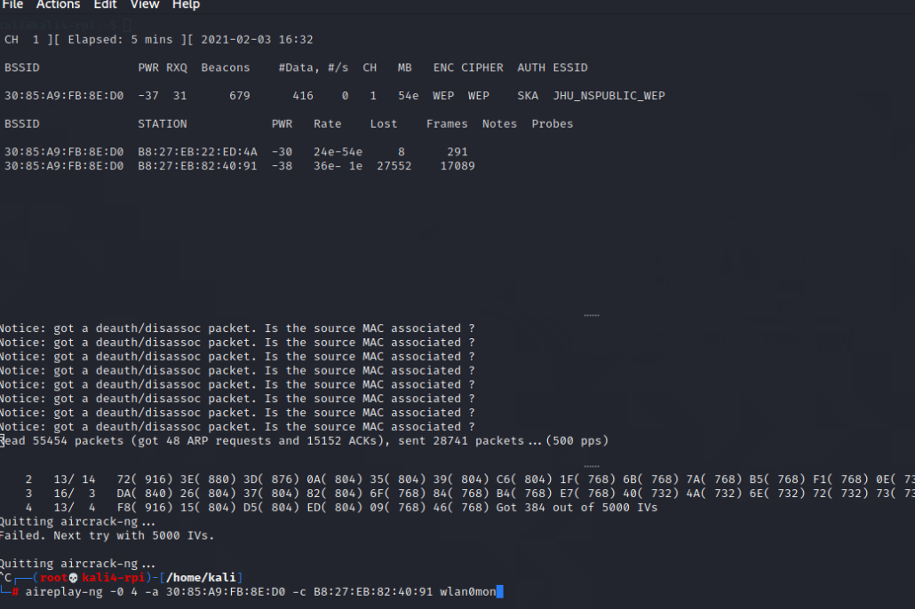
Project Execution

Slide 11
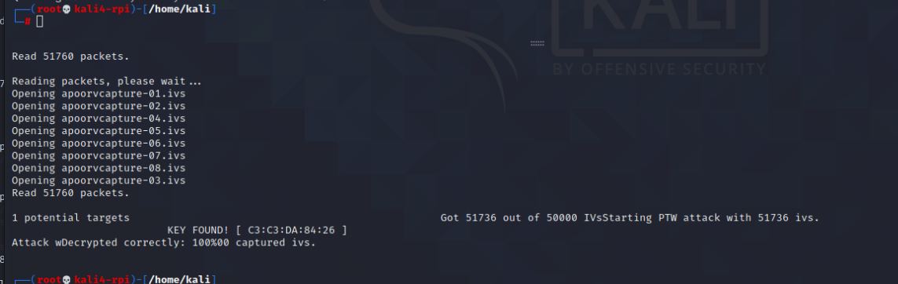
Project Execution
I was able to crack the WEP key after I collected about 40k IVs.

Slide 12
Project Execution
In order to infiltrate into the JHU_NSPUBLIC_WEP network and upload file on one of the host I made use of the cracked key and nm-connection-editor
Ran nmap against one of the host identified in previous steps and found few open ports with services running on them
One such port was 21 which was running a FTP service that supported anonymous login
With this information in hand I was able to upload a file on that host

Slide 13
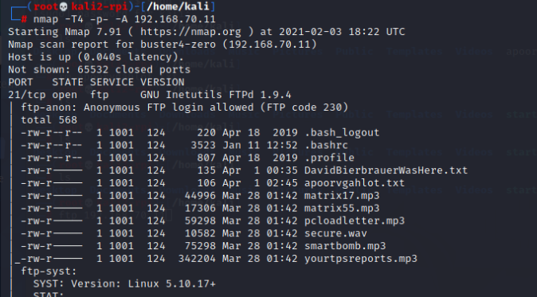
Project Execution

Slide 14
Network Security Policy/Recommendations
In order to protect against Man-in-the-middle attacks, and sniffing attacks etc WPA2 and AES should be implemented on access points.
Router Login Credentials should be stronger
Additionally make sure there are proper authentication mechanism implemented on the endpoint systems as well. In this case we saw that FTP allowed Anonymous login.
Open only ports which are necessary and avoid running services such as TELNET.

Slide 15
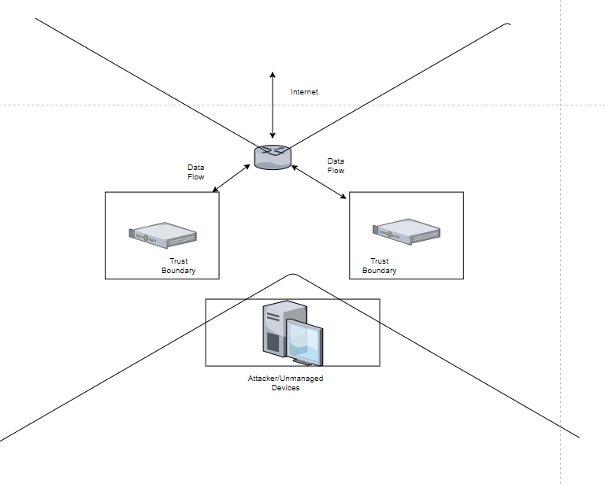
Overview Of Threat Model

Slide 16
Objectives Achieved (And Not Achieved)
Successfully performed Reconnaissance, Cracked WEP Key and Infiltrated in a network
Enumerated services running on a host with the help of nmap
As a result was able to upload a file on the host
However I was able to perform majority of these steps when MAC filtering was disabled. Will have to figure out a way to bypass it in future assignments.

Slide 17
Learnings
I learned how to setup a wireless interface in monitoring mode, how to crack wifi passwords.
Learned a great deal about the aircrack-ng tool
Learned about security vulnerabilities of WEP
From a security point of view I realized how important it is to implement strong password mechanisms, and also implement a strong encryption such as WPA2 on access points in order to prevent these kind of attacks.

Slide 18
The End
Thank You !

